Slide 1
TEAM
BABY SHARK
LYCEUM OF THE PHILIPPINES UNIVERSITY MANILA

Slide 2
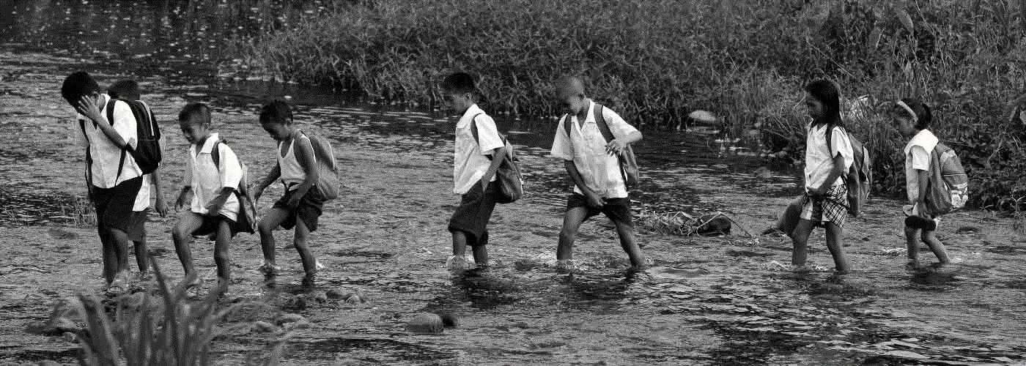

TEAM
BABY SHARK
LYCEUM OF THE PHILIPPINES UNIVERSITY MANILA
#AskJuan
By the People, for the Nation

Slide 3
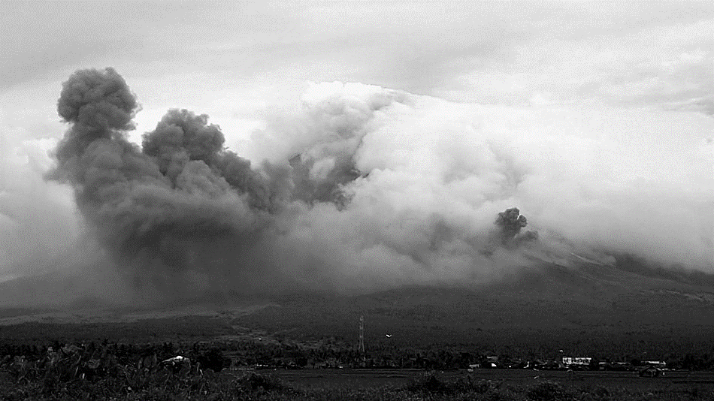
Approach
Nation Building for us
Empower our Nation
#AskJuan
Team Baby Shark LYCEUM OF THE PHILIPPINES UNIVERSITY

Slide 4
1
Please sign in
917 XXX XXXX
REQUEST CODE
Go to page 2
© Baby Shark 2018

Slide 5
2
Your verification code has been sent!
XXXX
VERIFY
Go to page 3
© Baby Shark 2018

Slide 6
#AskJuan
3 - User
Cat 1
Cat 2
Cat 3
Cat 4
Cat 5
Cat 6
Cat 7
Select a category to go to
their own page 4
3

Slide 7
#AskJuan
Category 1
Question 1
Yes
No
Question 2
Yes
No
Question 3
Yes
No
Submit
Go back to page 3
4

Slide 8
Register
First Name
Barangay
Juan
Poblacion II
Middle Name
Phone number
Santiago
917 XXX XXXX
Last Name
Picture
Dela Cruz
Upload file…
Gender
Male
REGISTER
Female
Street
Canonico Street
Go to page 1
City
Quezon City

